Slide 1


Enabling ZigBee Backscatter Communication in a Crowded Spectrum
Zhaoyuan Xu and Wei Gong
University of Science and Technology of China

Slide 2








Wireless Communication Enables Ubiquitous IoT Connectivity
Requirement 1: Low power consumption

Slide 3



Wireless Communication Enables Ubiquitous IoT Connectivity
…
Requirement 2: High spectrum efficiency
2.4 G

Slide 4

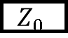
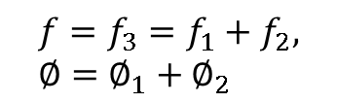

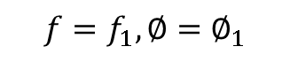
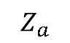
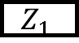
Backscatter Primer
Absorb
$$Z_{a}$$
$$Z_{0}$$
Carrier signal
Reflect
Backscatter signal
$$Z_{1}$$
Transmitter
Tag
Receiver
Backscatter signal is created!
Reflect
Absorb
$$f=f_{1}, ∅=∅_{1}$$
$$f=f_{2},∅=∅_{2}$$
$$f=f_{3}=f_{1}+f_{2}, ∅=∅_{1}+∅_{2}$$

Slide 5

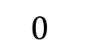
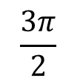
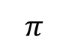
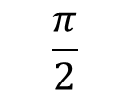
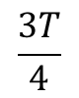
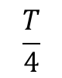
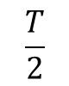
Backscatter Primer
0
$$π$$
0
Frequency harmonics!
$$0$$
$$\frac{π}{2}$$
$$\frac{T}{4}$$
$$\frac{T}{2}$$
$$π$$
$$\frac{3π}{2}$$
$$\frac{3T}{4}$$
Discontinuous phase shift produces much frequency harmonics!

Slide 6
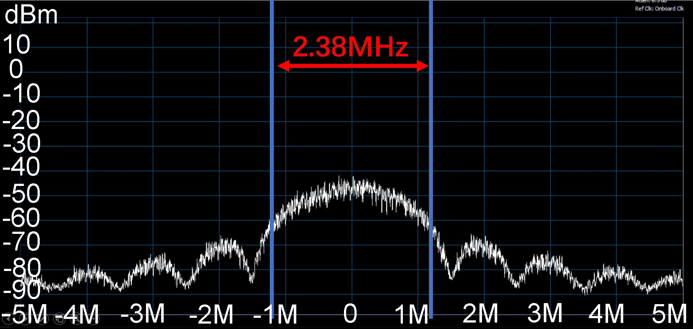
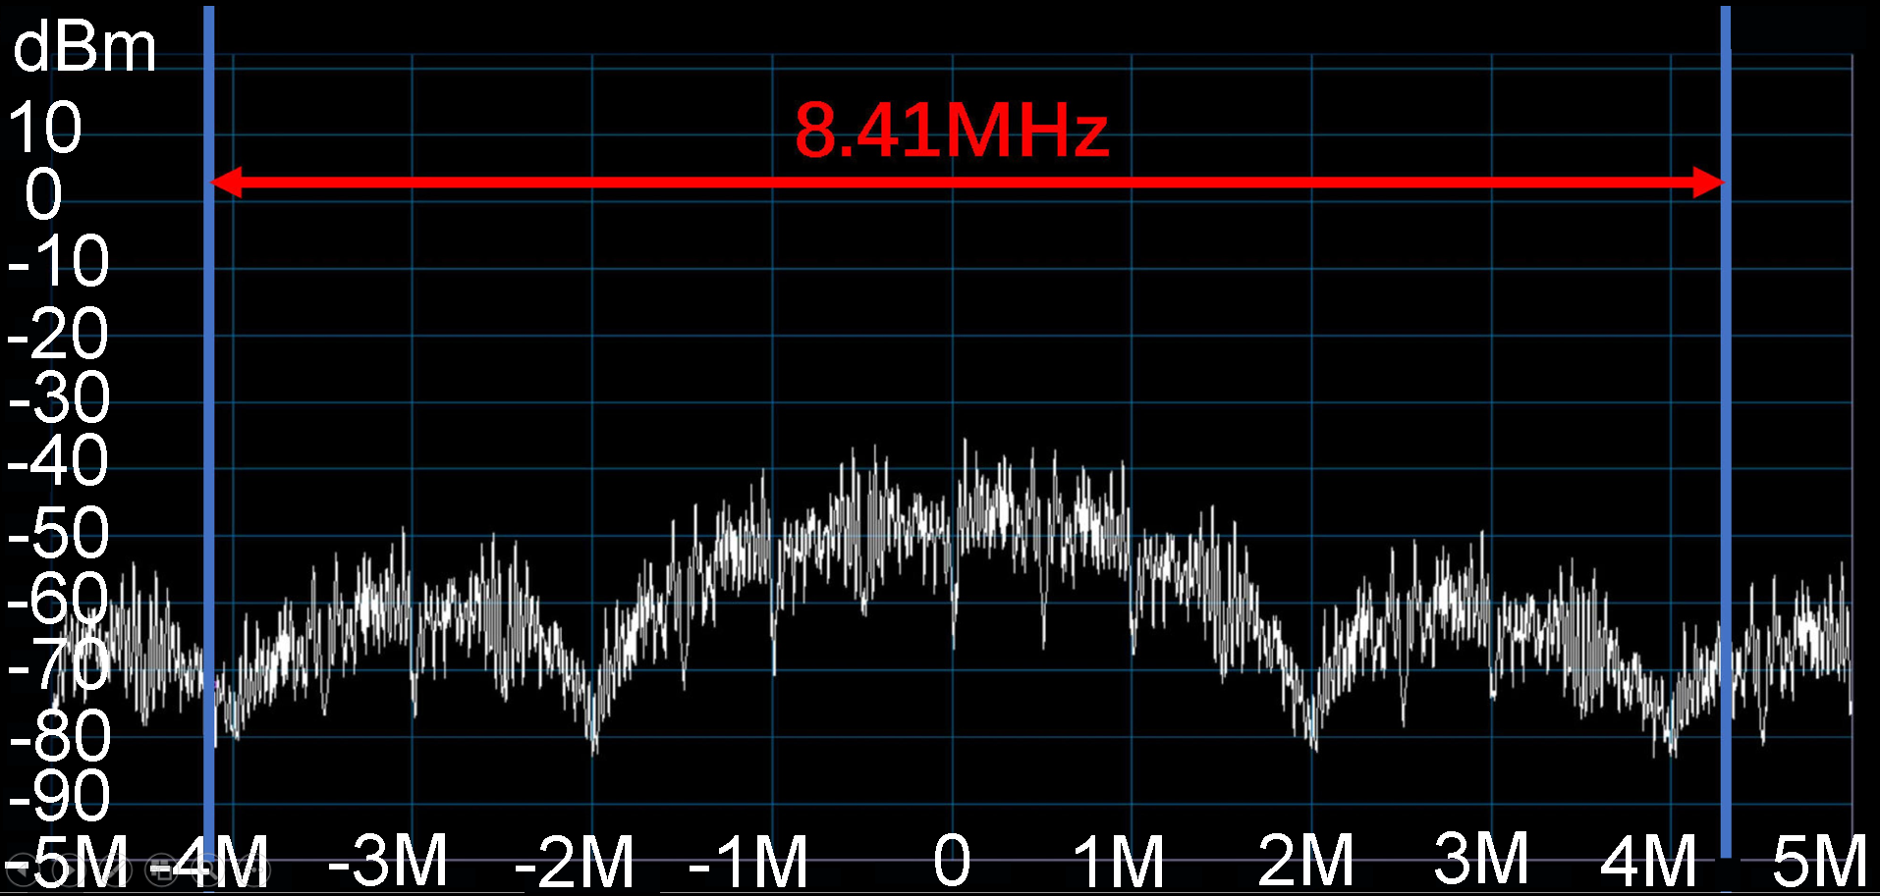
Backscatter Primer
Device working on neighbor channels
Ideal backscatter tag
Conventional backscatter tag
strength
strength
Commodity ZigBee spectrum
frequency
frequency
ZigBee backscatter spectrum
Discontinuous phase shift has low spectrum efficiency and disturbs the formation of large networks.

Slide 7
Can we enable ZigBee backscatter communication in a crowded spectrum?

Slide 8
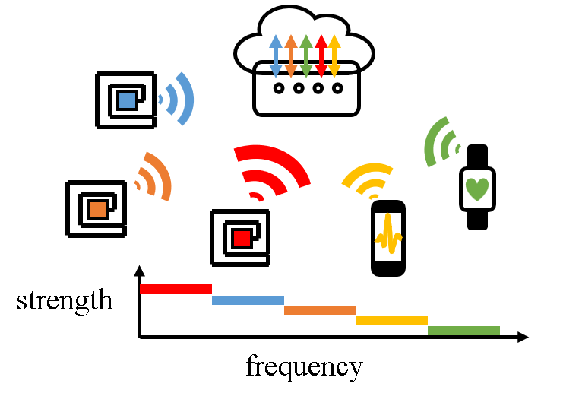

System Overview
ZigBee Transmitter
Backscatter Tag
ZigBee Receivers
The spectrum efficiency is 2.38 MHz, which is the same as active radios.
2. Commodity ZigBee radios provide reliable RF carriers.
3. Our tag achieves 100% carrier utilization.

Slide 9
Challenges
How to improve spectrum efficiency with discrete impedance states?
How to generate reliable RF carriers with commodity ZigBee radios?
How to improve carrier utilization on ambient carriers?

Slide 10
Challenge 1
How to improve spectrum efficiency with discrete impedance states?

Slide 11
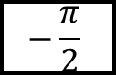
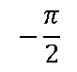
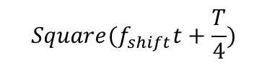
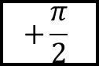
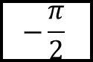

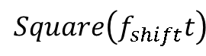
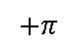
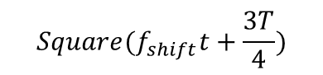
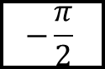
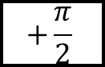
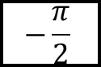
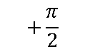
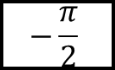
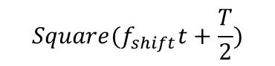
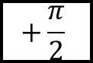
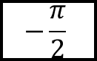
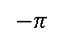
Instantaneous Phase Shift Modulation
…
phase shift sequence
$$+\frac{π}{2}$$
$$+\frac{π}{2}$$
$$−\frac{π}{2}$$
$$−\frac{π}{2}$$
$$−\frac{π}{2}$$
$$−\frac{π}{2}$$
$$−\frac{π}{2}$$
$$−\frac{π}{2}$$
$$+\frac{π}{2}$$
$$+π$$
$$+\frac{π}{2}$$
$$0$$
phase
$$−\frac{π}{2}$$
$$−π$$
$$Square\left(f_{shift}t\right)$$
$$Square(f_{shift}t+\frac{T}{4})$$
T/4
$$Square(f_{shift}t+\frac{T}{2})$$
T/2
$$Square(f_{shift}t+\frac{3T}{4})$$
3T/4
Instantaneous phase shift (IPS) modulation takes square waves to emulate phase shift.

Slide 12

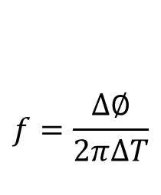
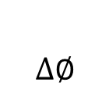
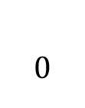
Intuitive Idea
Frequency harmonics!
Instantaneous phase shift (IPS) modulation produces discrete phase shift.
IPS modulation has low spectrum efficiency.
$$0$$
$$f=\frac{∆∅}{2π∆T}$$
$$∆∅$$
Square 1
Square 3
Square 2

Slide 13
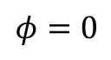
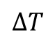
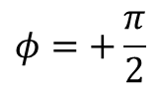
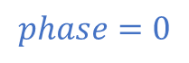
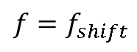
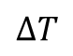
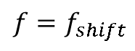
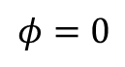
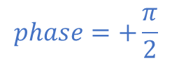
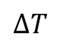
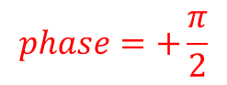
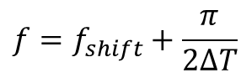
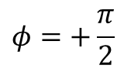
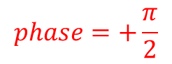
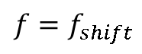

Intuitive Idea
$$phase=+\frac{π}{2}$$
$$phase=+\frac{π}{2}$$
$$phase=+\frac{π}{2}$$
$$phase=0$$
$$∆T$$
$$∆T$$
$$∆T$$
$$∆T$$
Parameter 1
$$f=f_{shift}$$
$$f=f_{shift}$$
$$f=f_{shift}+\frac{π}{2∆T}$$
$$f=f_{shift}$$
$$φ=0$$
$$φ=+\frac{π}{2}$$
$$φ=+\frac{π}{2}$$
Parameter 2
$$φ=0$$

Slide 14






Frequency Phase Shift Modulation
…
phase shift sequence
$$+\frac{π}{2}$$
$$+\frac{π}{2}$$
$$−\frac{π}{2}$$
$$−\frac{π}{2}$$
$$−\frac{π}{2}$$
$$−\frac{π}{2}$$
$$−\frac{π}{2}$$
$$−\frac{π}{2}$$
$$+\frac{π}{2}$$
$$+π$$
$$+\frac{π}{2}$$
$$f_{FP}$$
phase
$$0$$
$$−\frac{π}{2}$$
$$−π$$
IPS modulation
Frequency Phase Shift (FPS) modulation

Slide 15




State Machine
Phase transition | phase | Frequency deviation
$$0→+\frac{π}{2}$$ | 0 | $${f_{shift}+f}_{FP}=+\frac{π}{2∆T}$$
$$0→−\frac{π}{2}$$ | 0 | $${f_{shift}−f}_{FP}=−\frac{π}{2∆T}$$
Q
$$+\frac{π}{2}→+π$$ | $$+\frac{π}{2}$$ | $${f_{shift}+f}_{FP}=+\frac{π}{2∆T}$$
$$+\frac{π}{2}→0$$ | $$+\frac{π}{2}$$ | $${f_{shift}−f}_{FP}=−\frac{π}{2∆T}$$
I
I
$$π→+\frac{3π}{2}$$ | $$π$$ | $$f_{shift}{+f}_{FP}=+\frac{π}{2∆T}$$
$$π→+\frac{π}{2}$$ | $$π$$ | $${f_{shift}−f}_{FP}=−\frac{π}{2∆T}$$
How to schedule multiply square waves for the generation of FPS-ZigBee?
$$+\frac{3π}{2}→0$$ | $$+\frac{3π}{2}$$ | $${f_{shift}+f}_{FP}=+\frac{π}{2∆T}$$
$$+\frac{3π}{2}→−π$$ | $$+\frac{3π}{2}$$ | $${f_{shift}−f}_{FP}=−\frac{π}{2∆T}$$

Slide 16
Challenge 2
How to generate reliable RF carriers with commodity ZigBee radios?

Slide 17



Commodity ZigBee Transmitter
Constant amplitude, phase, and frequency.
raw bit
32
$$c_{0}c_{1}c_{2}c_{3}c_{4}c_{5}c_{6}c_{7}{ c}_{8}…c_{28} c_{29}c_{30}c_{31}$$
0
110110011…1110
1
111011011…0010
pulse shaping filter
2
001011101…0010
DAC
up converter
…
…
$$T_{c}$$
$$s(t)$$
14
100101100…1100
15
110010010…1000
$$p(t)$$
Commodity ZigBee radio takes DSSS to spread data bits, which blocks single-tone generation.

Slide 18



Commodity ZigBee Transmitter
AT86RF233
AT86RF231
ATMEGA256RF2
raw bit
32
$$c_{0}c_{1}c_{2}c_{3}c_{4}c_{5}c_{6}c_{7}{ c}_{8}…c_{28} c_{29}c_{30}c_{31}$$
0
110110011…1110
1
111011011…0010
pulse shaping filter
2
001011101…0010
DAC
up converter
…
…
$$T_{c}$$
$$s(t)$$
14
100101100…1100
15
110010010…1000
$$p(t)$$

Slide 19
Challenge 3
How to improve carrier utilization on ambient non-single-tone?

Slide 20
Codeword Translation
SHR
PHR
Single-tone
SHR
PHR
Payload
Low carrier utilization
SHR
PHR
Payload
Codeword translation helps to improve carrier utilization

Slide 21






























Codeword Translation
$$f_{e}$$
$$f_{c}+f_{i}$$
$$f_{c}+f_{i}$$
$$f_{c}−f_{i}$$
$$f_{c}−f_{0}$$
Excitation
$$\frac{π}{2}$$
$$φ_{e}$$
$$0$$
$$\frac{π}{2}$$
$$π$$
$$f_{T}$$
$$f_{s}$$
$$f_{s}−2f_{i}$$
$$f_{s}+2f_{i}$$
$$f_{s}$$
Tag
$$π$$
$$φ_{T}$$
$$0$$
$$0$$
$$0$$
$$f_{B}$$
$$f_{c}+f_{s}+f_{i}$$
$$f_{c}+f_{s}−f_{i}$$
$$f_{c}+f_{s}+f_{i}$$
$$f_{c}+f_{s}−f_{i}$$
Backscatter
$$φ_{B}$$
$$0$$
$$\frac{π}{2}$$
$$0$$
$$\frac{π}{2}$$
Tag=Backscatter-Excitation

Slide 22

Implementation
Tag prototype:
Envelope detector: AD8313+Comparator
RF switch: ADG902
Processor: FPGA (ZYNQ7000)
Commodity ZigBee transmitter: ATMEGA256RF2
Commodity ZigBee receiver: TI CC2650

Slide 23


Evaluation
dBm
Atten: 34,8 dB
Ref Clk: Onboard Clk
dBm
Atten: 34,8 dB
Ref Clk: Onboard Clk
0
0
-10
-10
-20
500 K
-20
-500 K
-30
-30
-40
-40
-50
-50
-60
-60
-70
-70
-80
-80
-90
-90
-100
-100
-2.5M
-2M
-1.5M
-1M
-500K
0
500K
1M
1.5M
2M
2.5M
-2.5M
-2M
-1.5M
-1M
-500K
0
500K
1M
1.5M
2M
2.5M
PSDU=“000…”
PSDU=“111…”
Commodity ZigBee radios are able to provide single-tone carriers.

Slide 24



Evaluation
Commodity ZigBee
FPS modulation
IPS modulation
The spectrum of FPS modulation is comparable to the commodity ZigBee.

Slide 25
Evaluation
Device working on channel 1
Device working on channel 2
7 meters
15 meters
FPS modulation
IPS modulation
18 meters
strength
18 meters
frequency
Devices working on CH1 and CH2 suffer from IPS interference. Their communication distance are limited to 7 meters and 15 meters, respectively.
In comparison, devices work concurrently with FPS can be extended to over 18 meters.

Slide 26
Conclusion
We present FPS modulation, which is designed for RF switch toggling and is capable of improving spectrum efficiency.
We apply FPS practically to a ZigBee backscatter system and improve carrier utilization.
We build a hardware prototype on an FPGA platform and perform comprehensive experiments to validate the system’s effectiveness.

Slide 27
Thanks!
Zhaoyuan Xu
Contact: xzyjyx@mail.ustc.edu.cn

